Slide 1

TENSORFLOW 2.0
PRACTICAL ADVANCED

Slide 2

DEEP DREAM

Slide 3
WHAT IS DEEP DREAM?

Slide 4
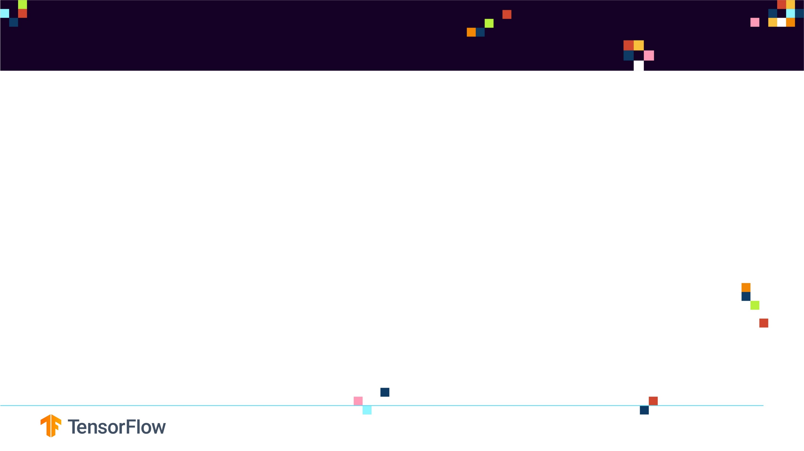
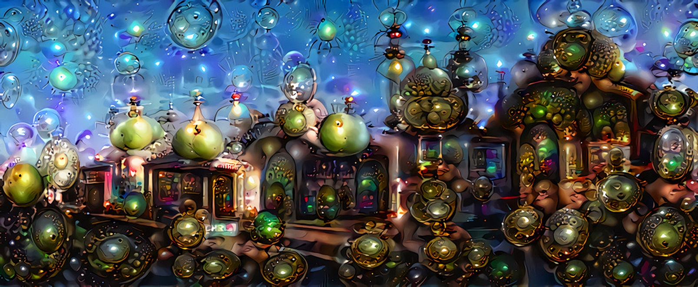
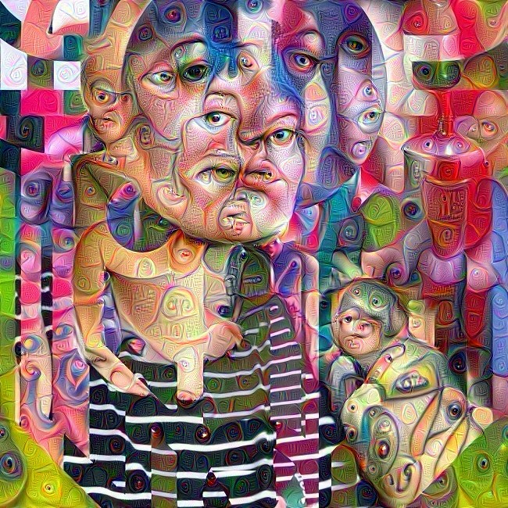
WHAT IS DEEP DREAM?
Deep Dream is the most freaky, creepy AI algorithm to date!
Ever wondered what does an AI see? (in the hidden layers)
Check out this Deep Dream Journey on YouTube : https://www.youtube.com/watch?v=SCE-QeDfXtA
Photo Credit: https://www.flickr.com/photos/pagedooley/19529912369
Photo Credit: https://www.flickr.com/photos/dominicspics/37965696745

Slide 5
WHAT IS DEEP DREAM?
Deep dream is a computer vision algorithm created by Alexander Mordvintsev from Google.
The algorithm works by creating dream-like effect.
It’s like giving humans an extremely powerful drug!
Check this out:
https://www.google.com/search?q=acid&tbm=isch&sxsrf=ACYBGNS0AIW2MCpicRYIQKKfe9awnqhOJw:1567002661159&chips=q:acid,g_1:trippy:RToMNSdMJh4=&tbas=0&source=lnt&sa=X&ved=0ahUKEwjG0uvn46XkAhVEOq0KHSAPAVgQpwUIJA&biw=1920&bih=937&dpr=1
As you increasingly feed the image to the network, the more weird features will start to pop up.
Check out this repository of images on Dreamscope:
https://dreamscopeapp.com/

Slide 6

DEEP DREAM SIMILAR TO HUMANS?
Remember when you were a kid looking at the clouds and trying to interpret shapes? This is a horse, here’s a dog..
DeepDream does the same thing by boosting the patterns it sees in a given image based on what it has been trained to see in the past (during training).
If a network has been trained to see animals in images, it will try to extract animal features in any given image.
Photo Credit: https://pixabay.com/photos/child-little-kid-sit-balloons-sky-2747141/

Slide 7
HOW DOES THE DEEP DREAM ALGORITHM WORK?

Slide 8
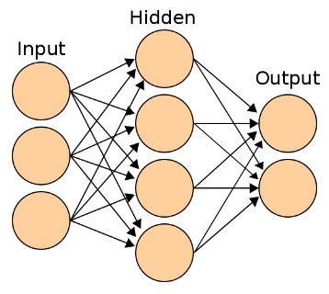
HOW DOES THE DEEP DREAM ALGO WORK?
If you feed an image to a CNN, the first layers generally detect low-level features such as edges.
As you go deeper in the network, higher level features are then detected such as faces, trees, and cars.
“The final few layers assemble those into complete interpretations—these neurons activate in response to very complex things such as entire buildings or trees,” Google’s engineers explain.
LOW LEVEL FEATURES
HIGH LEVEL FEATURES
CONVOLUTIONAL LAYERS
FULLY CONNECTED (DENSE) LAYERS
Training Data
CONVOLUTION
AFRICAN ELEPHANTS
SNAKES
LIONS
KERNELS/
FEATURE DETECTORS LAYER #1
KERNELS/
FEATURE DETECTORS LAYER #2
KERNELS/
FEATURE DETECTORS LAYER #3

Slide 9
HOW DOES THE DEEP DREAM ALGO WORK?
What if you ask a certain layer to improve what it detects in an image?
What if you ask the first couple of layers that are experts in detecting edges to maximize what they see?
What if you ask the last couple of layers (deeper ones) that are experts in detecting elements (higher level features such as cars, faces..) to increase what they really see?
Things get really dreamy and amazing! That’s what Google named: “inceptionism”
Check this out:
https://gizmodo.com/these-are-the-incredible-day-dreams-of-artificial-neura-1712226908

Slide 10
HOW DOES THE DEEP DREAM ALGO WORK?
When you feed in an image to a trained ANN, the neurons fire and generate activations.
The deep dream algorithm work by trying to change the input image in a way that would make some of these neurons fire more (boost the neurons firing or activations). You can select which neurons in which layer you are interested in making them fire more prominently.
The process is continuously repeated until the input image now contains all features that a specific layer was originally looking for.
Example: if a certain layer was expert in recognizing dog faces and you feed in an image of a blue sky, the deep dream algorithm will continuously change the input image and start creating images of dogs faces on top of the blue sky. The process keep repeating until the layer of interest is happy with the results!

Slide 11
DEEP DREAM MATH
Deep Dream Steps:
Forward an image through a trained ANN, CNN, ResNet..etc
Select a layer of choice (first layers capture edges, deep layers capture full shapes such as faces)
Calculate the activations (output) coming out from the layer of interest.
Calculate the gradient of the activations with respect to the input image with
Modify the image to increase these activations, and thus enhance the patterns seen by the network resulting in trippy hallucinated image!
Iterate and repeat over multiple scales

Slide 12
DEEPDREAM CONCEPT SIMPLIFIED

Slide 13

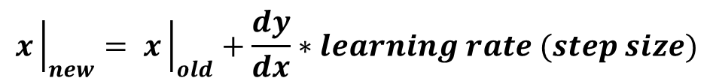
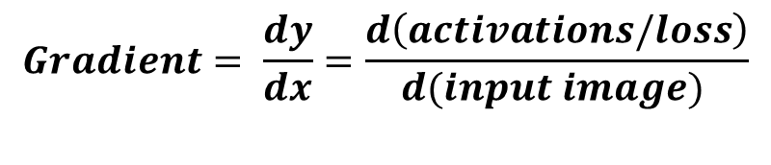
DEEP DREAM CONCEPT SIMPLIFIED
Deep Dream Steps:
Forward an image through a trained ANN, CNN, ResNet..etc
Select a layer of choice (first layers capture edges, deep layers capture full shapes such as faces)
Calculate the activations (output) coming out from the layer of interest.
Calculate gradient of loss (activations) with respect to the pixels of the input image.
Modify the image to increase these activations, and thus enhance the patterns seen by the network resulting in trippy hallucinated image!
TRAINED MODEL
$$y=b+m∗x$$
DEPENDANT VARIABLE
(ACTIVATIONS/LOSS)
INDEPENDENT VARIABLE
(INPUT IMAGE)
Y (ACTIVATIONS)
$$Gradient= \frac{dy}{dx}=\frac{d\left(activations/loss\right)}{d(input image) }$$
$$x{\left.​\right|}_{new}= x{\left.​\right|}_{old}+\frac{dy}{dx}∗learning rate (step size)$$
DEEPDREAM PERFORMS GRADIENT “ASCENT” TO EXCITE THE ACTIVATIONS (OUTPUTS)
X (INPUT IMAGE)

